Slide 1









Introduction to
Algorithm Design and Analysis
[13] Undirected Graph
Yu Huang
http://cs.nju.edu.cn/yuhuang Institute of Computer Software Nanjing University

Slide 2

In the last class…
Directed Acyclic Graph
Topological Order
Critical Path Analysis
Strongly Connected Component
Strong Component and Condensation
Finding SCC based on DFS

Slide 3

DFS on Undirected Graph
Undirected Graph
Symmetric Digraph
Undirected Graph DFS Skeleton
Biconnected Components
Articulation Points and 2-point connectedness
Bridge and 2-edge connectedness
Other undirected graph problems
Orientation of an undirected graph
Warm up: Minimum Spanning Tree based on DFS

Slide 4



What is Different for “Undirected”
Characteristics of undirected graph traversal
One edge may be traversed for two times in opposite directions.
For an undirected graph, DFS provides an orientation for each of its edges
Oriented in the direction in which they are first encountered.

Slide 5

Edges in DFS
Cross edge
Not existing
Back edge
Back to the direct parent: second encounter
Otherwise: first encounter
Forward edge
Always second encounter, and first time as back edge

Slide 6


Modifications to the DFS Skeleton
All the second encounter are bypassed.
So, the only substantial modification is for the possible back edges leading to an ancestor, but not direct parent.
We need know the parent, that is, the direct ancestor, for the vertex to be processed.

Slide 7




DFS Skeleton for Undirected Graph
int dfsSweep(IntList[] adjVertices,int n, …)
int ans;
<Allocate color array and initialize to white>
For each vertex v of G, in some order
if (color[v]==white)
int vAns=dfs(adjVertices, color, v, -1, …);
<Process vAns>
// Continue loop
return ans;
Recording the parent

Slide 8


DFS Skeleton for Undirected Graph
int dfs(IntList[] adjVertices, int[] color, int v, int p, …)
int w; IntList remAdj; int ans;
color[v]=gray;
<Preorder processing of vertex v>
remAdj=adjVertices[v];
while (remAdj≠nil)
w=first(remAdj);
if (color[w]==white)
<Exploratory processing for tree edge vw>
int wAns=dfs(adjVertices, color, w, v …);
< Backtrack processing for tree edge vw , using wAns>
else if (color[w]==gray && w≠p)
<Checking for nontree edge vw>
remAdj=rest(remAdj);
<Postorder processing of vertex v, including final computation of ans>
color[v]=black;
return ans;

Slide 9


Complexity of Undirected DFS
Θ(m+n)
If each inserted statement for specialized application runs in constant time
The same with directed graph DFS
Extra space Θ(n)
For array color, or activation frames of recursion.

Slide 10


Biconnected Graph
Node biconnected
Articulation point
v is an articulation point if there exist nodes w and x, such that v is in every path from w to x (w and x are vertices different from v)
Edge biconnected
Bridge
uv is a bridge if node u and v are connected only by edge uv
Bicomponent
Maximal biconnected subgraph

Slide 11



Articulation Points
G
I
B
G
B
I
Partitioning the set of edges, not of the vertices
C
E
E
B
C
E
F
H
F
J
H
F
J
A
D
A
D

Slide 12








Articulation Point Algorithm
Ancestors of v
v is an articulation point iff no back edges linking any vertex in some w-rooted subtree and any ancestor of v.
v
If v is the articulation point farthest away from the root on the branch, then one bicomponent is detected.
w
Subtree rooted at w
Back edge

Slide 13




Updating the value of back
v first discovered
back=discoverTime(v)
Trying to explore, but a back edge vw from
v encountered
back=min(back, discoverTime(w))
Backtracking from w to v back=min(back, wback)
The back value of v is the smallest discover time a back edge “sees” from any subtree of v.

Slide 14






Example
second back edge encountered
G
G
I
I
B
5/5
B
C
C
6/6
E
4/4
E
3/3
F
3/1
F
H
J
H
J
A
D
A
D 2/2
1/1
2/2
1/1
first back edge encountered

Slide 15







Example
G
8/8
G
9/9
I
backtracking
third back edge encountered
I
5/4
B
5/4
B
C
6/4
C
6/4
4/4
E
4/4
E
3/1
F
3/1
F
H
J
H
J
A
D
2/2
A
D
2/2
1/1
1/1

Slide 16


Example
8/5
backtracking
5/4
8/5
9/5
I
G
9/5
I
G
backtracking: gBack=discoverTime(B), so, first bicomponent detected.
5/4
B
B
C
C
4/4
3/1
4/4
E
6/4
E
6/4
3/1
F
H
F
J
H
J
A
D
2/2
A
D
2/2
1/1
1/1

Slide 17





Keeping the Track of Backing
Tracking data
For each vertex v, a local variable back is used to store the required information, as the value of discoverTime of some vertex.
Testing for bicomponent
At backtracking from w to v, the condition implying a bicomponent is:
wBack ≥ discoverTime(v) (where wBack is the returned back value for w)
when back is no less than the discover time of v, there is at least one subtree of v connected to other part of the graph only by v.
17

Slide 18

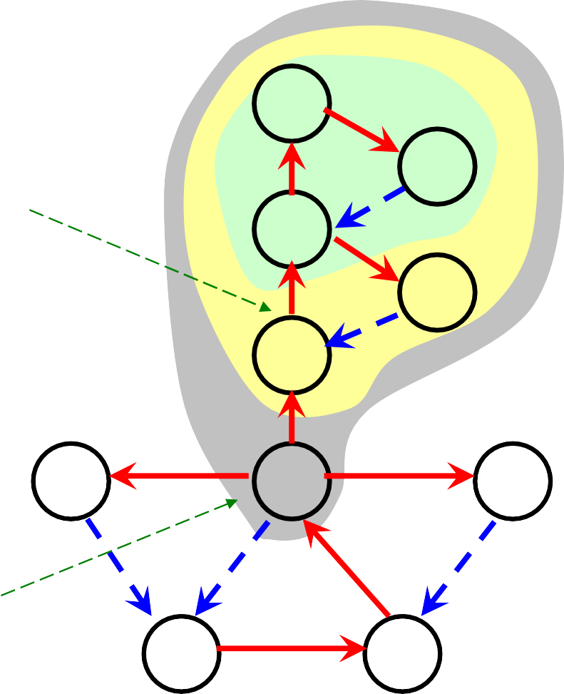
Example
8/5
G
9/5
I
Backtracking from B to E: bBack=discoverTime(E), so, the second bicomponent is detect
5/4
B
C
4/4
E
6/4
14/1
H
3/1
F
16/2
J
Backtracking from E to F: eBack>discoverTime(F), so, the third bicomponent is detect
A
D
2/2
1/1
17

Slide 19

Articulation Point Algorithm
int bicompDFS(v)
•
•
•
•
•
•
•
•
•
•
else if (vw is a back edge)
back=min(discoverTime[w], back);
time++; finishTime[v]=time; color[v]=black;
return back;
Outline of
core procedure
color[v]=gray; time++; discoverTime[v]=time; back=discoverTime[v];
while (there is an untraversed edge vw)
<push vw into edgeStack> if (vw is a tree edge)
wBack=bicompDFS(w);
if (wBack≥discoverTime[v])
Output a new bicomponent
by popping edgeStack down through vw ;
back=min(back, wBack);
17

Slide 20

Correctness
We have seen that:
If v is the articulation point farthest away from the root on the branch, then one bicomponent is detected.
So, we need only prove that:
In a DFS tree, a vertex(not root) v is an articulation point if and only if (1) v is not a leaf; (2) some subtree of v has no back edge incident with a proper ancestor of v.
17

Slide 21


Characteristics of Articulation Point
In a DFS tree, a vertex(not root) v is an articulation point if and only if (1)v is not a leaf; (2) some subtree of v has no back edge incident with a proper ancestor of v.
⇐ Trivial
⇒
By definition, v is on every path between some x,y(different from v).
At least one of x,y is a proper descendent of v(otherwise, x↔root↔y
not containing v).
By contradiction, suppose that every subtree of v has a back edge to a proper ancestor of v, we can find a xy-path not containing v for all possible cases(only 2 cases)
17

Slide 22











Case 1
Case 1.2: another is an ancestor of v
suppose that every subtree of v has a back edge to a proper ancestor of v, and, exactly one
y
y
v
v
of x, y is a descendant of v.
x
x
Case 1.1: another is not an ancestor of v
17

Slide 23



Case 2
suppose that every subtree of v has a back edge to a proper ancestor of v, and, both x, y are descendants of v.
v
y
x
17

Slide 24


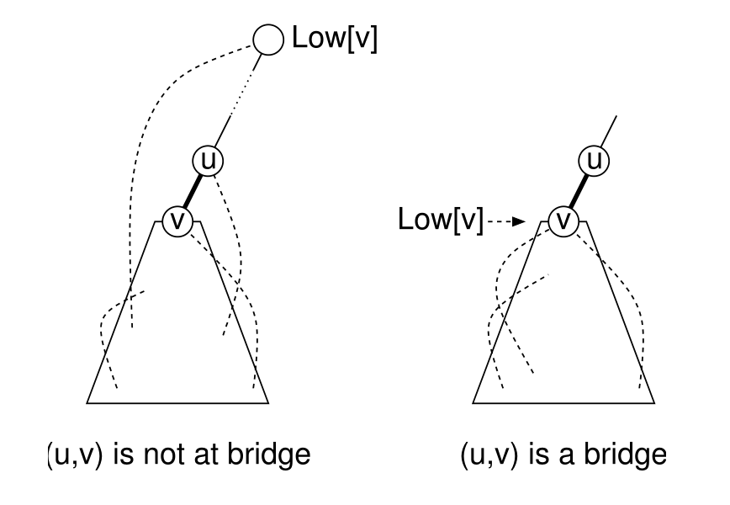
Finding the Bridge
17

Slide 25




Finding the Bridge
Edge uv is a bridge iff
o (assuming that u is the parent and v is the child)
Edge uv is a tree edge in DFS
There is no subtree rooted at v to a proper ancestor of v (including u)
Why!
17

Slide 26


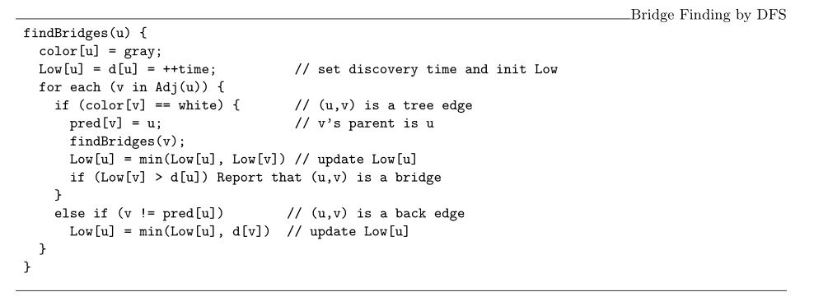
Edge Finding Algorithm
17

Slide 27


Orientation for Undirected Graphs
Orientation
Give each edge a direction
Satisfying pre-specified constraints
E.g., the “in-degree of each vertex is at least 1”
Possible or not?
If possible, how to?
As for “in-degree ≥ 1”
Orientation possible iff. the graph has at least a circle
Find the end point of some back edge
A second DFS from this end point
17

Slide 28

Warm Up for MST
MST: Minimum
Get MST in O(m+n) time
Spanning Tree
o Given that edges weights are only 1 and 2
Graph traversal is sufficient
DFS over “weight 1 edges” only
DFS over “weight 2 edges” only
17

Slide 29




Thank you!
Q & A
Yu Huang
http://cs.nju.edu.cn/yuhuang
17

